Slide 2
Ideal 5G NR 100M Different Power VSA Demod Test
Pout | 5dBm | 8dBm | 9dBm | 10 dBm | 11 dBm | 12 dBm | 13 dBm | 14 dBm | -40 dBm | -38 dBm | -36 dBm | -35 dBm | -33 dBm | -30 dBm
EVM | -44.94 dB | -44.97 dB | -44.62 dB | -44.91 dB | -44.57 dB | -44.43 dB | -43.84 dB | -42.79 dB | -39.77 dB | -40.29 dB | -40.81 dB | -41.31 dB | -41.78 dB | -41.53 dB
IQ offset | -47.07 dB | -47.02 dB | -46.97 dB | -47.14 dB | -46.97 dB | -47.00 dB | -46.94 dB | -47.07 dB | -47.68 dB | -50.48 dB | -46.89 dB | -46.79 dB | -46.69 dB | -47.06 dB
Density | -130.8 | -127 | -126.7 | -125 | -124.5 | -123 | -122.1 | -120.7 | -161.6 | -160.9 | -160 | -158.9 | -157.5 | -155.5

Slide 3
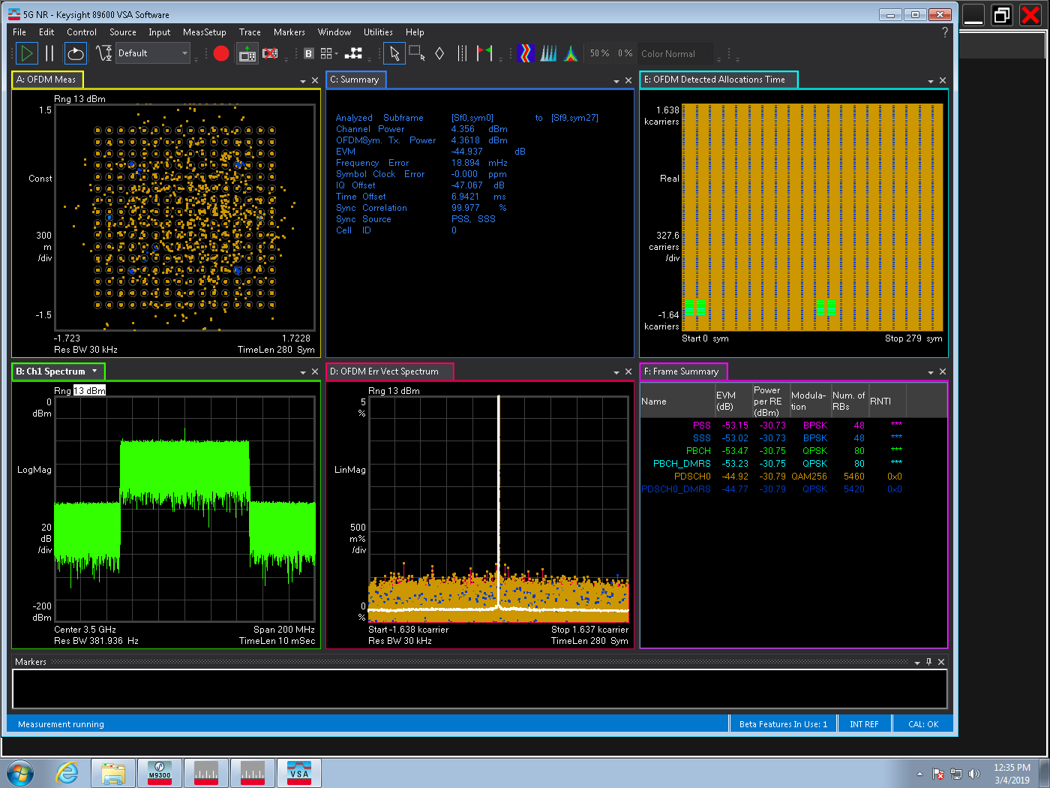
Ideal NR 100M VXT Cable Test Pout=5dB
EVM：-44.94 dB
IQ offset：-47.07dB

Slide 4
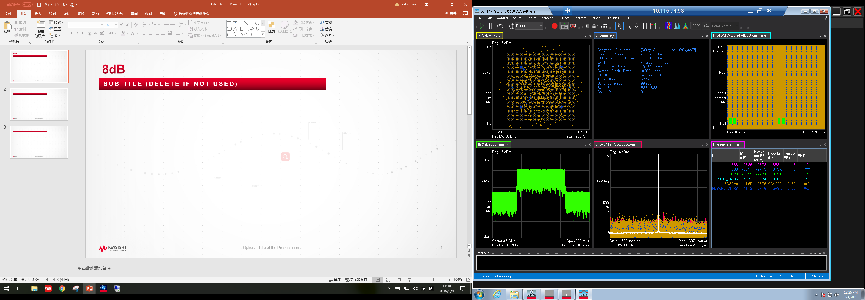
Ideal NR 100M VXT Cable Test Power=8dB
EVM：-44.97 dB
IQ offset：-47.02dB

Slide 5

Ideal NR 100M VXT Cable Test Power=9dB
EVM：-44.62 dB
IQ offset：-46.97dB

Slide 6

Ideal NR 100M VXT Cable Test Power=10dB
EVM：-44.91 dB
IQ offset：-47.14dB

Slide 7

Ideal NR 100M VXT Cable Test Power=11dB
EVM：-44.57 dB
IQ offset：-46.97dB

Slide 8
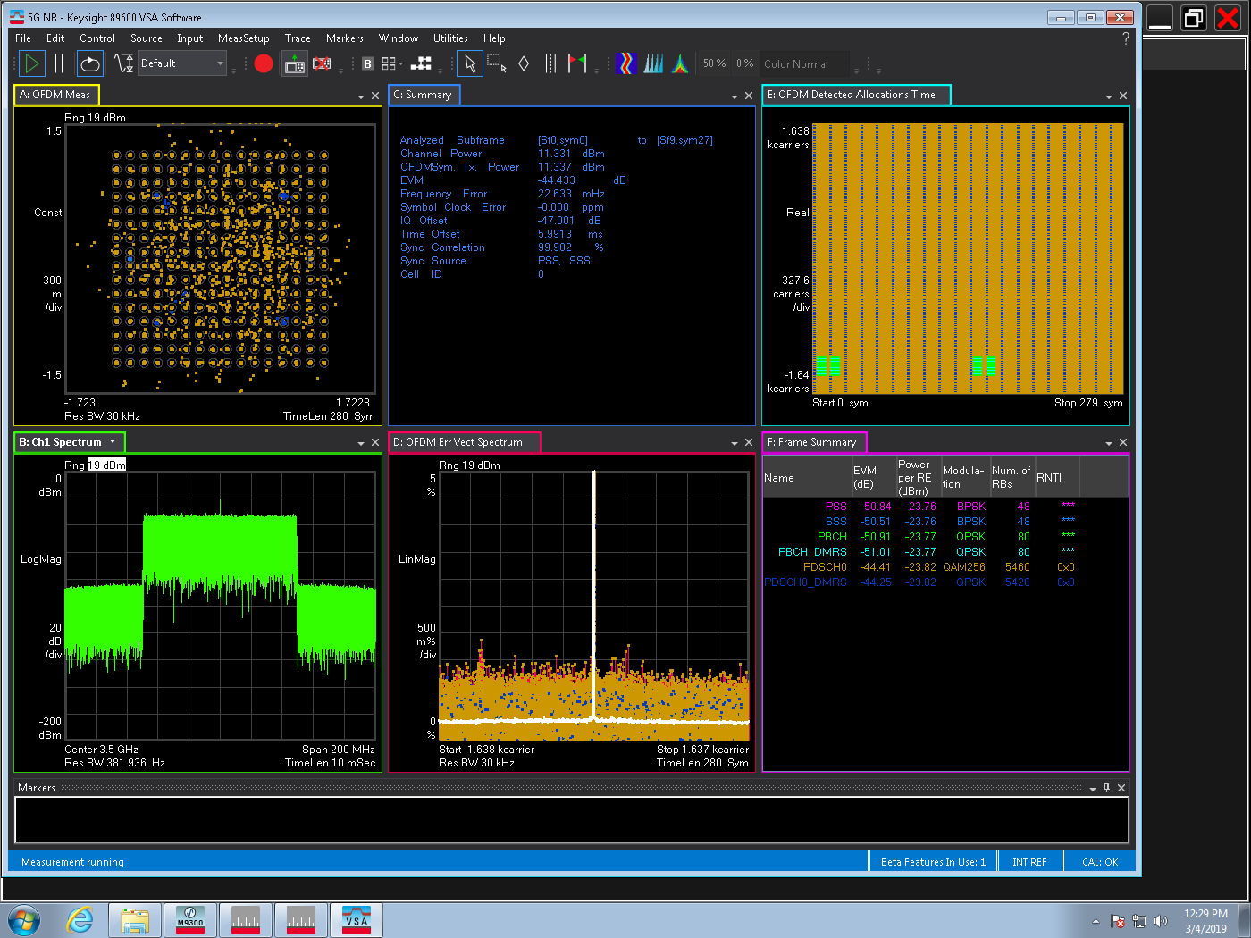
Ideal NR 100M VXT Cable Test Power=12dB
EVM：-44.43 dB
IQ offset：-47.00dB

Slide 9
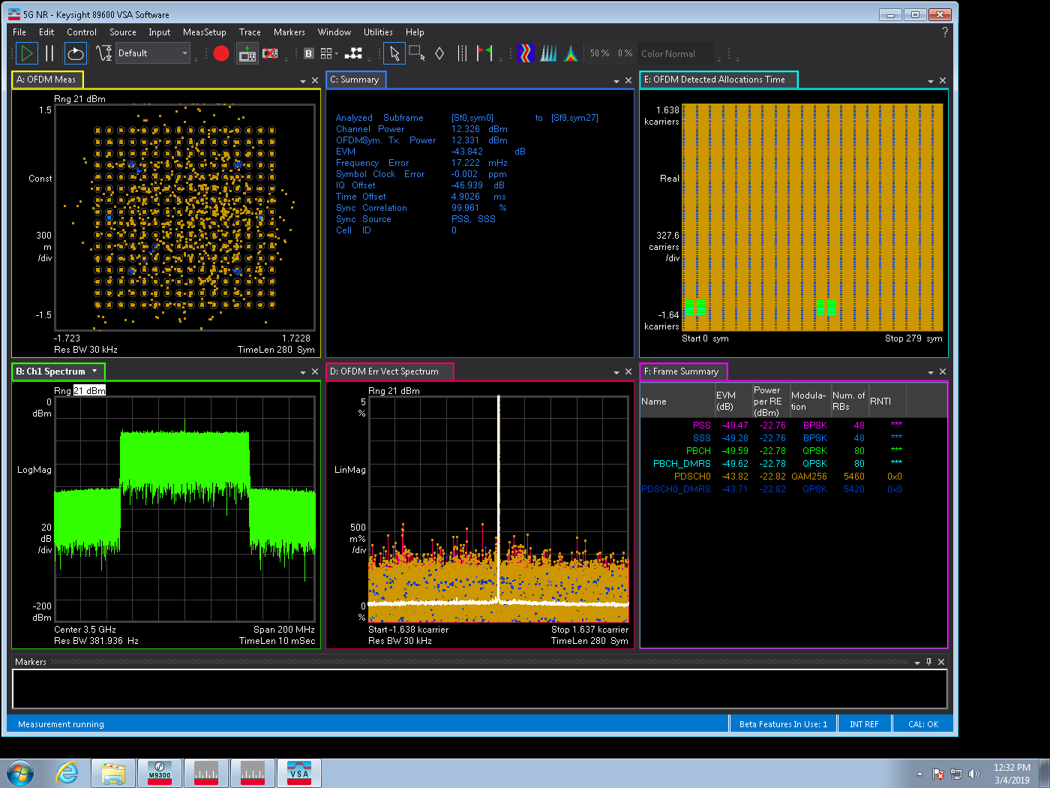
Ideal NR 100M VXT Cable Test Power=13dB
EVM：-43.84 dB
IQ offset：-46.94dB

Slide 10
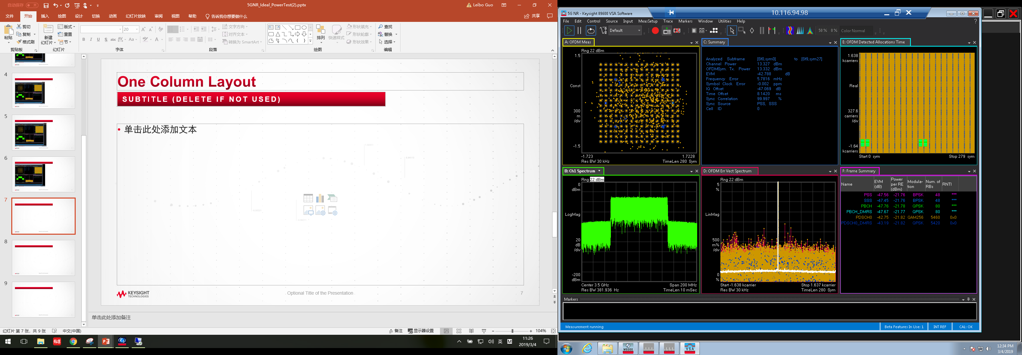
Ideal NR 100M VXT Cable Test Power=14dB
EVM：-42.79 dB
IQ offset：-47.07dB

Slide 11
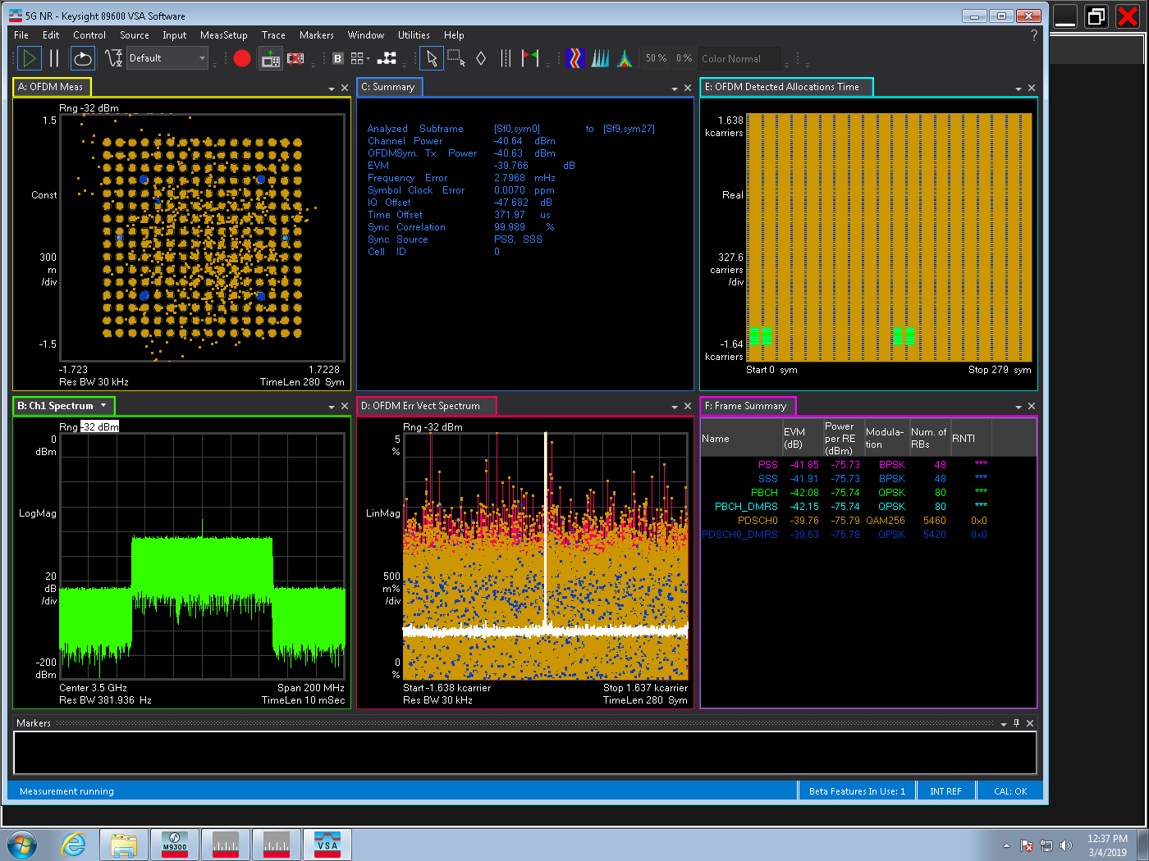
Ideal NR 100M VXT Cable Test Power=-40dB
EVM：-39.77 dB
IQ offset：-47.68dB

Slide 12
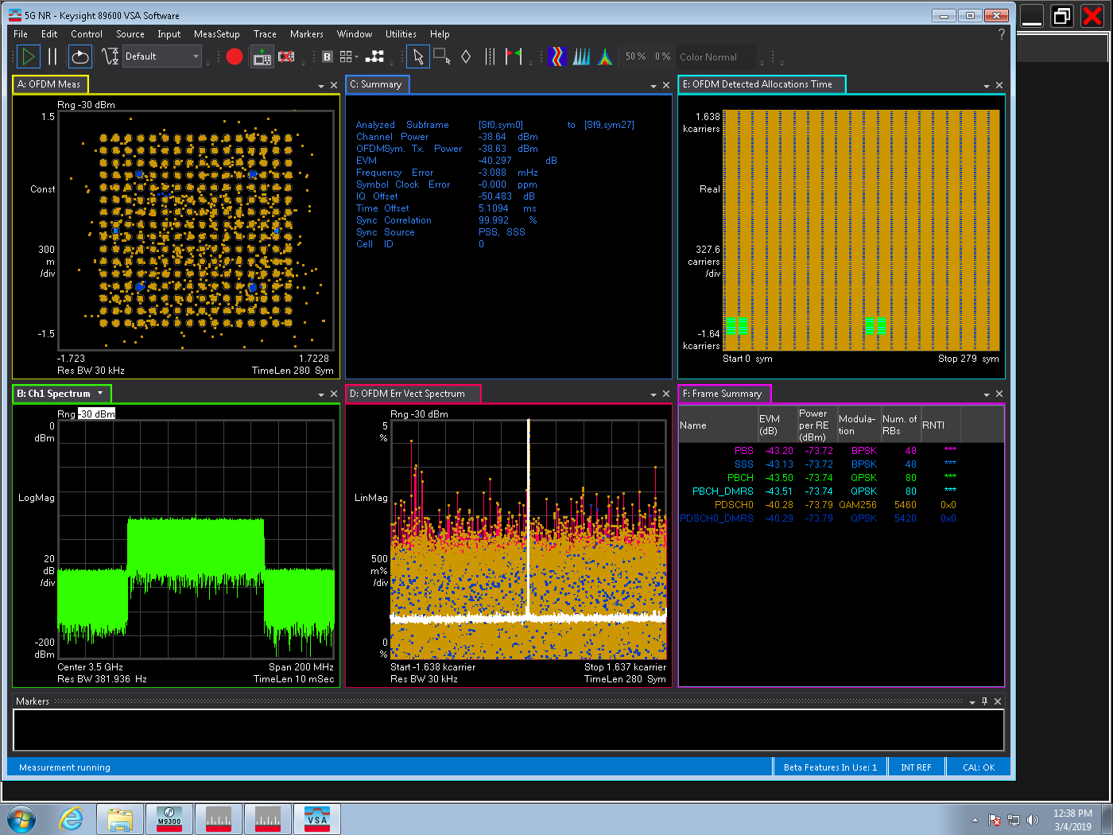
Ideal NR 100M VXT Cable Test Power=-38dB
EVM：-40.297 dB
IQ offset：-50.48dB

Slide 13
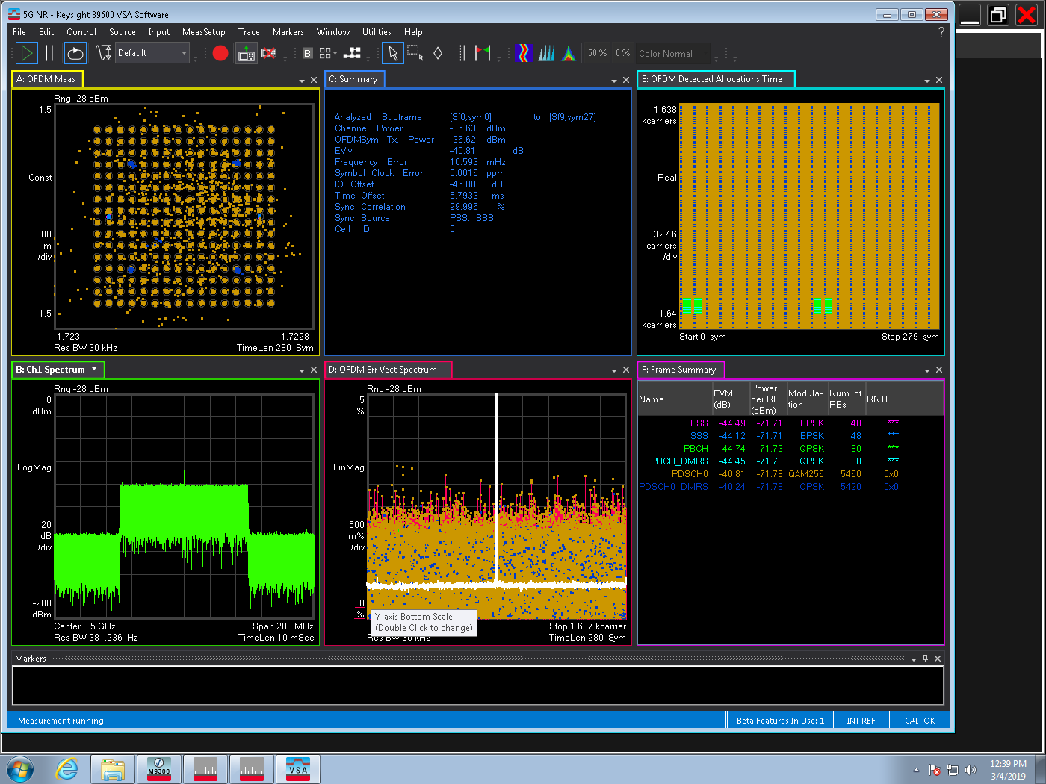
Ideal NR 100M VXT Cable Test Power=-36dB
EVM：-40.81 dB
IQ offset：-46.89dB

Slide 14

Ideal NR 100M VXT Cable Test Power=-35dB
EVM：-41.31 dB
IQ offset：-46.79dB

Slide 15
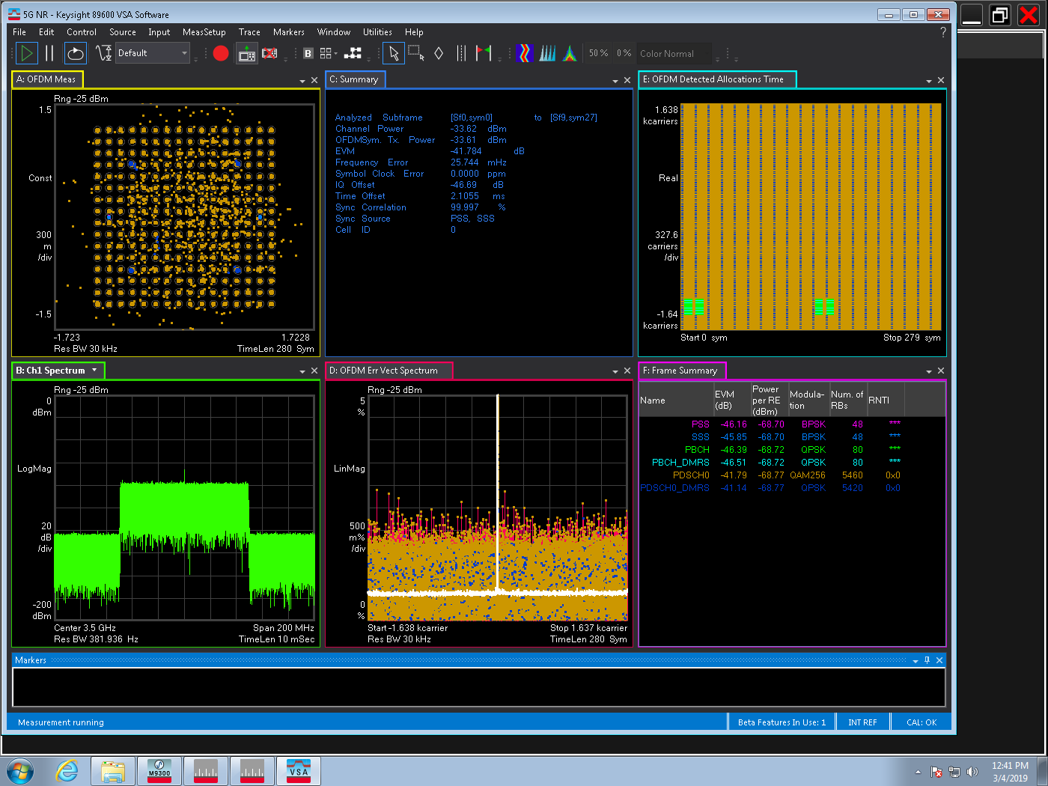
Ideal NR 100M VXT Cable Test Power=-33dB
EVM：-41.78 dB
IQ offset：-46.69dB

Slide 16
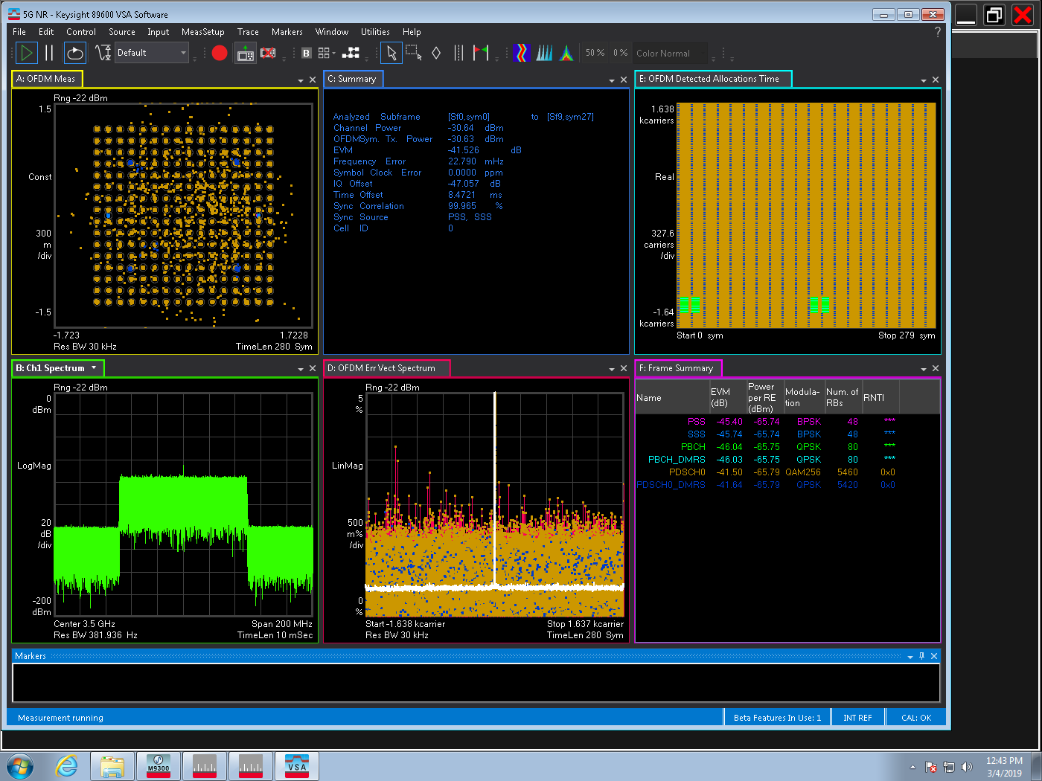
Ideal NR 100M VXT Cable Test Power=-30dB
EVM：-41.53 dB
IQ offset：-47.06dB

Slide 17
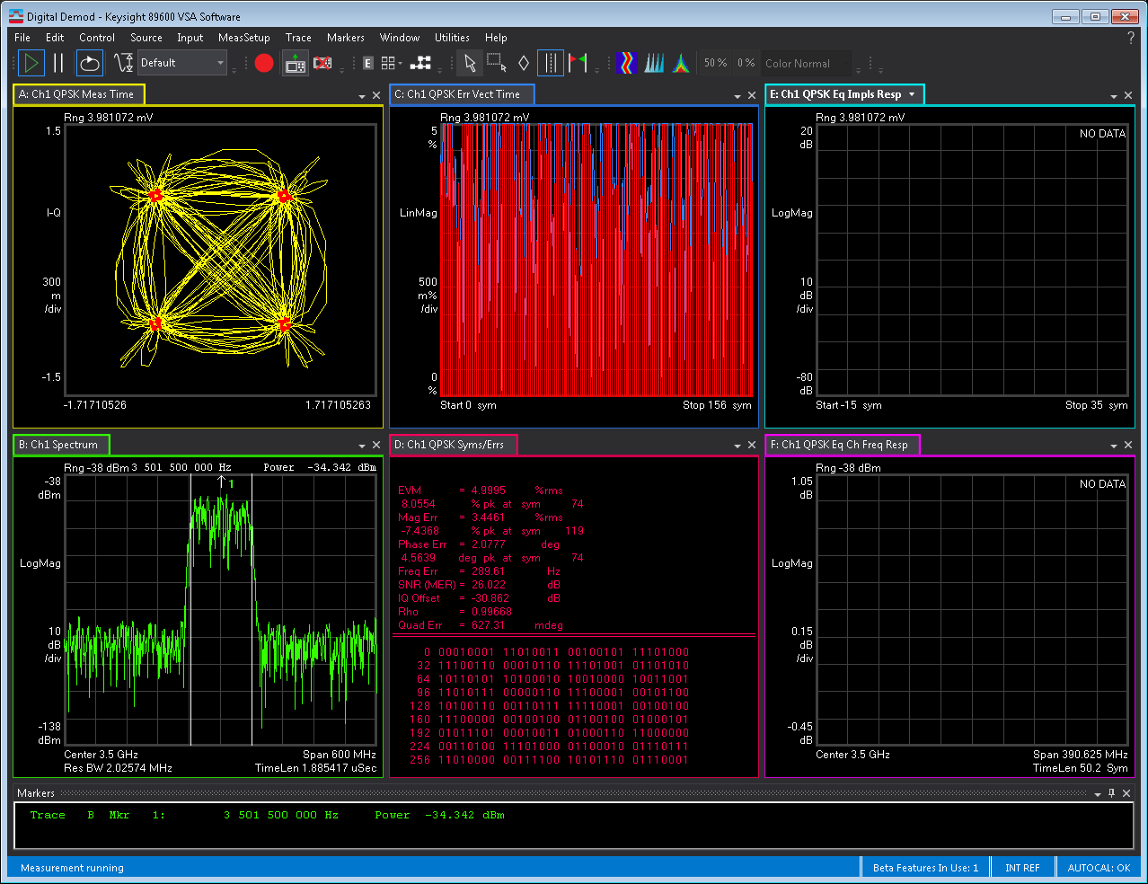
QPSK 100M Chamber Pout=10dB
EVM：5%
IQ offset：-30.862dB
SNR=26.02

Slide 18
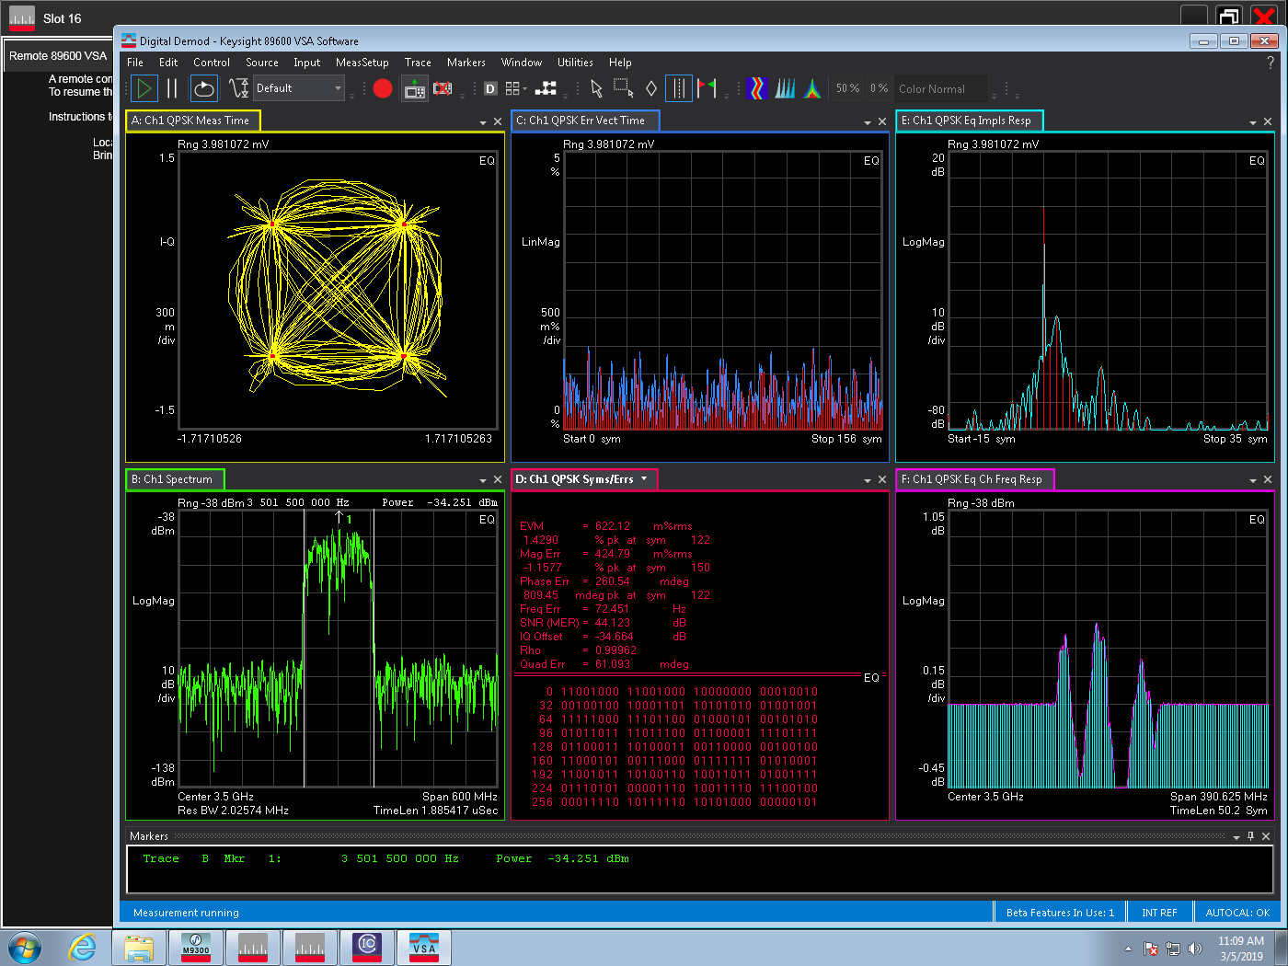
QPSK 100M Chamber Pout=10dB eq
EVM：0.6%
IQ offset：-34.664dB
SNR=44.123

Slide 19
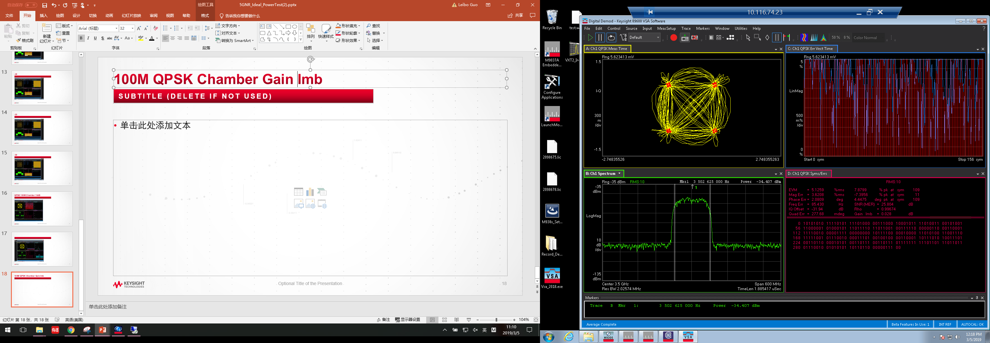
100M QPSK Chamber Gain Imb=0.028
Gain Imb=0.028
IQ offset：-31.94dB

Slide 20
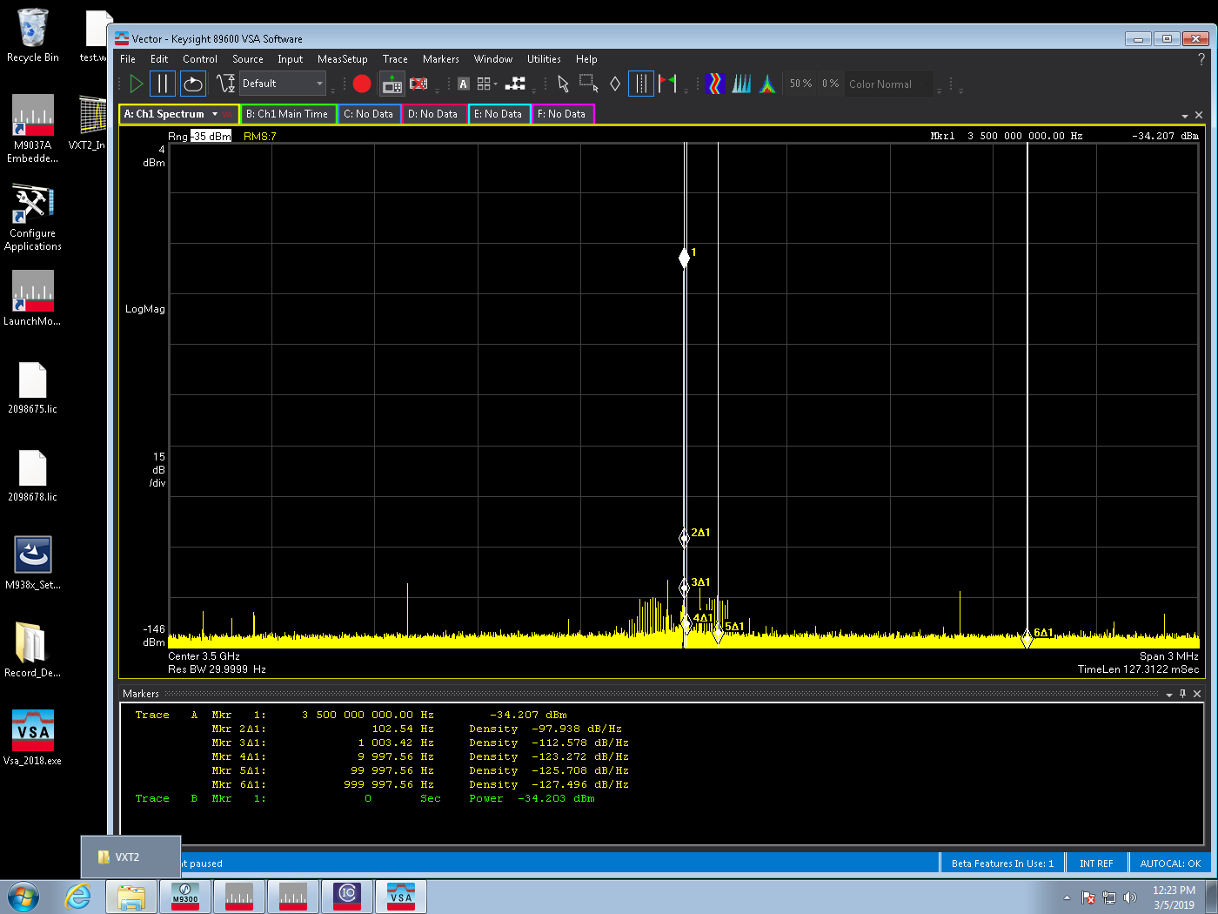
100M QPSK Chamber Phase Noise
PhaseNoise=[100 -97.9 1000
-112.6 10000 -123.3]

Slide 21
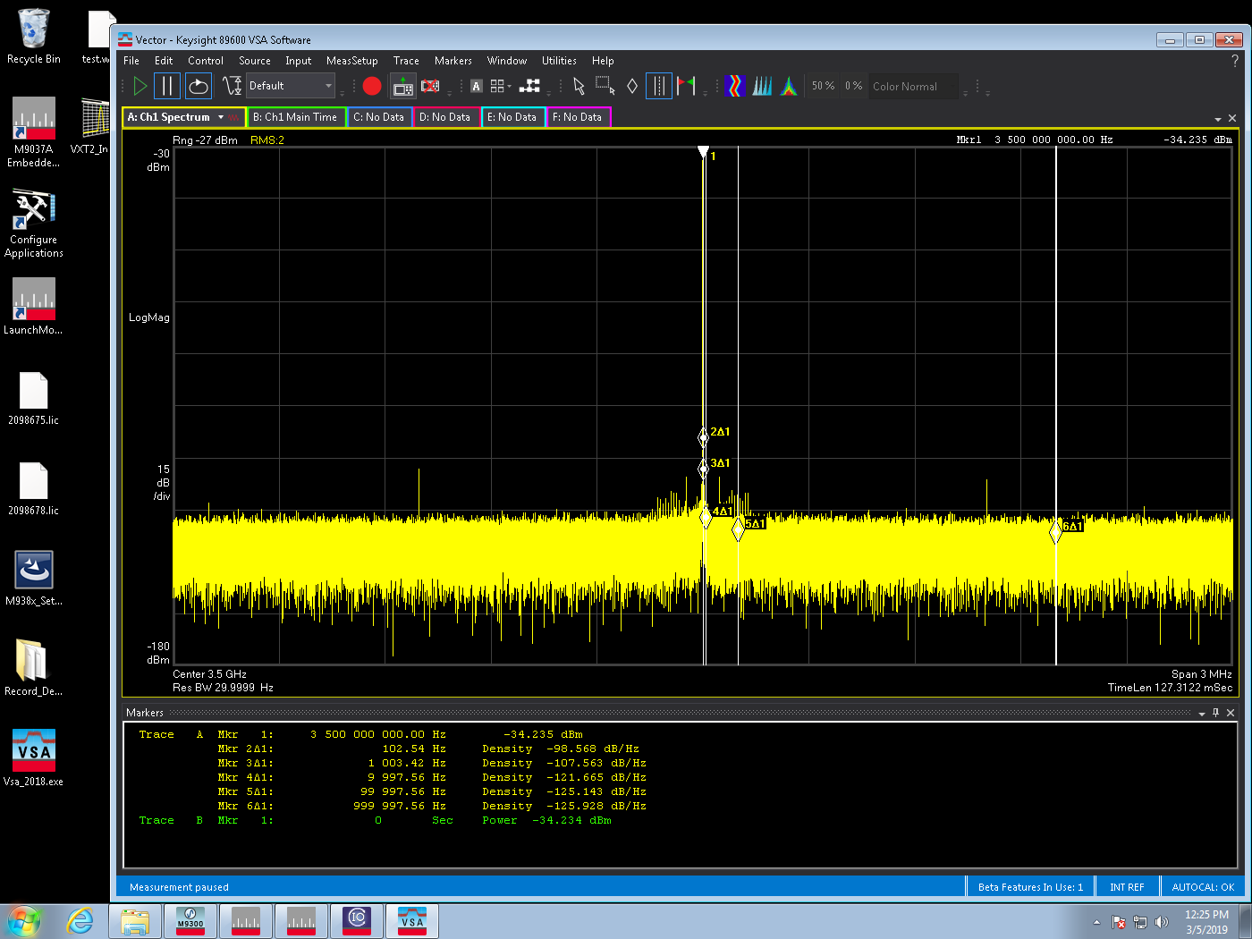
100M QPSK Chamber Phase Noise(range+8dB)
PhaseNoise=[100 -98.6 1000
-107.6 10000 -121.7]

Slide 22
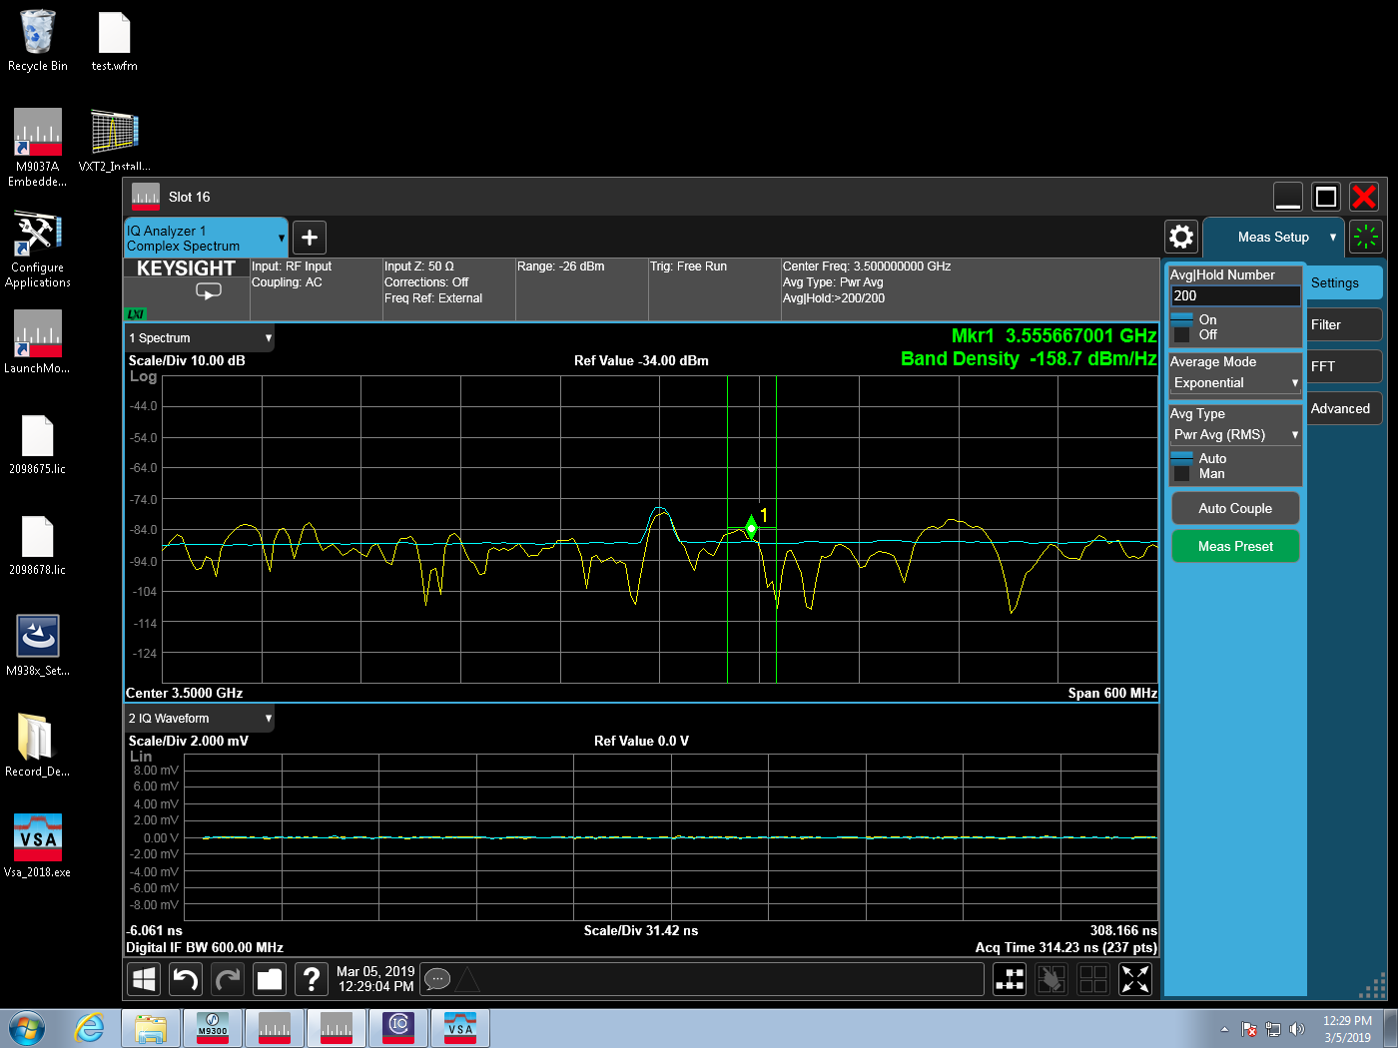
100M QPSK Chamber
Noise Density=-158.7

Slide 23
仪表参数：
Density=-158.7
IQoffset=0.0045
Gain Imb=0.002
PhaseNoise=[100 -98.57 1e3 -107.56 1e4 -121.67]
DAC_Nbits=14
Imp 测试参数：
Density=-158.7
IQoffset=0.045
Gain Imb=0.02
PhaseNoise=[100 -88.57 1e3 -97.56 1e4 -111.67]
DAC_Nbits=12
TOIout=20

Slide 24
5GNR B2 Chamber Test
100MHz BW，Pout = 10dBm
B2_PassLoss= -53dB, RxPower=-34dB
Ideal | Imp
EVM(dB) | Chamber | SV1 | Delta
Total | -42.26 | -42.755 | 0.495
PSS | -45.43 | -44.51 | 0.92
SSS | -45.34 | -44.57 | 0.77
PBCH | -45.60 | -45.00 | 0.6
PBCH_DMRS | -45.53 | -45.25 | 0.28
PDSCH0 | -42.24 | -42.74 | 0.5
PDSCH0_DMRS | -42.33 | -42.99 | 0.66
Lower ACLR | -44.776 | -43.326 | 1.45
Upper ACLR | -44.376 | -43.362 | 1.014
EVM(dB) | Chamber | SV | Delta
Total | -34.409 | -34.764 | 0.355
PSS | -36.83 | -37.25 | 0.42
SSS | -36.90 | -37.24 | 0.34
PBCH | -36.99 | -37.35 | 0.36
PBCH_DMRS | -36.64 | -37.17 | 0.53
PDSCH0 | -34.39 | -34.75 | 0.36
PDSCH0_DMRS | -34.52 | -34.91 | 0.39
Lower ACLR | -40.827 | -40.388 | 0.439
upper ACLR | -40.777 | -40.357 | 0.42

Slide 25
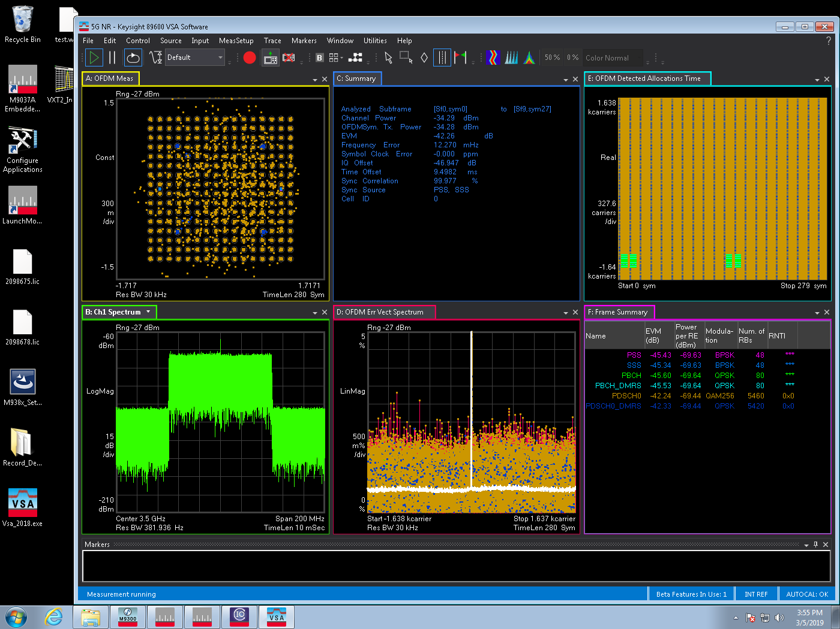
Ideal NR 100M Chamber Pout=10dB
EVM=-42.26
IQ offset=-46.947

Slide 26
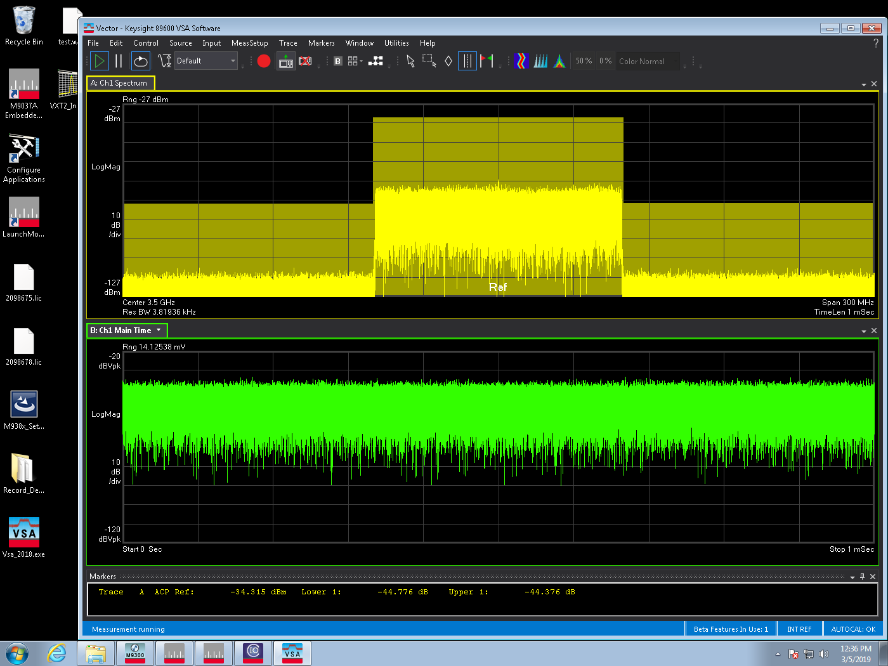
Ideal NR 100M Chamber 10dB ACLR
Lower ACLR=-44.776
Upper ACLR =-43.376

Slide 27
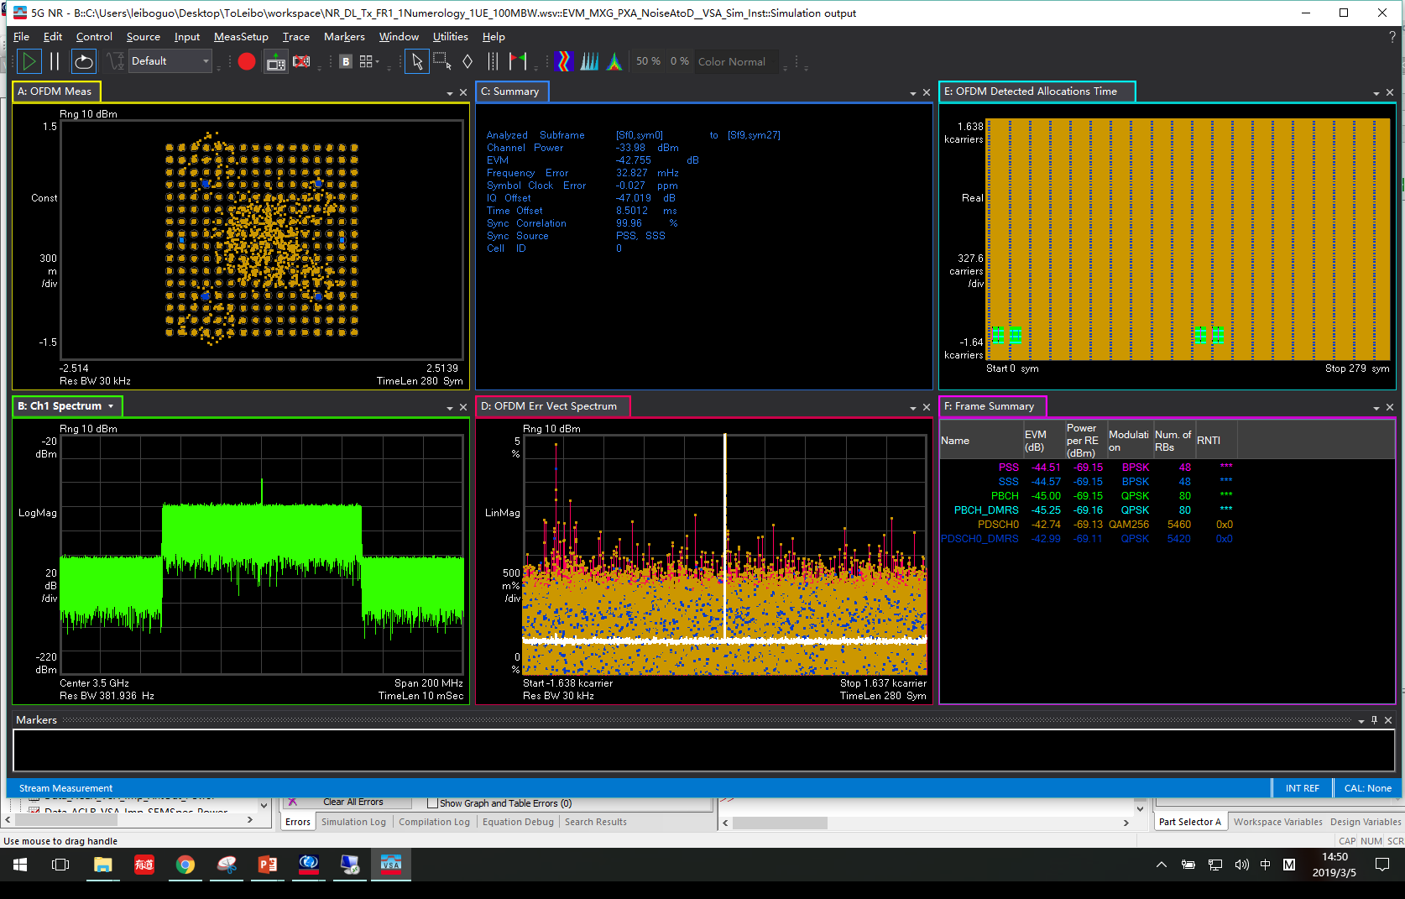
Sim Ideal NR 100M Pout=-34dB
EVM=-42. 76
IQ offset=-47.019

Slide 28
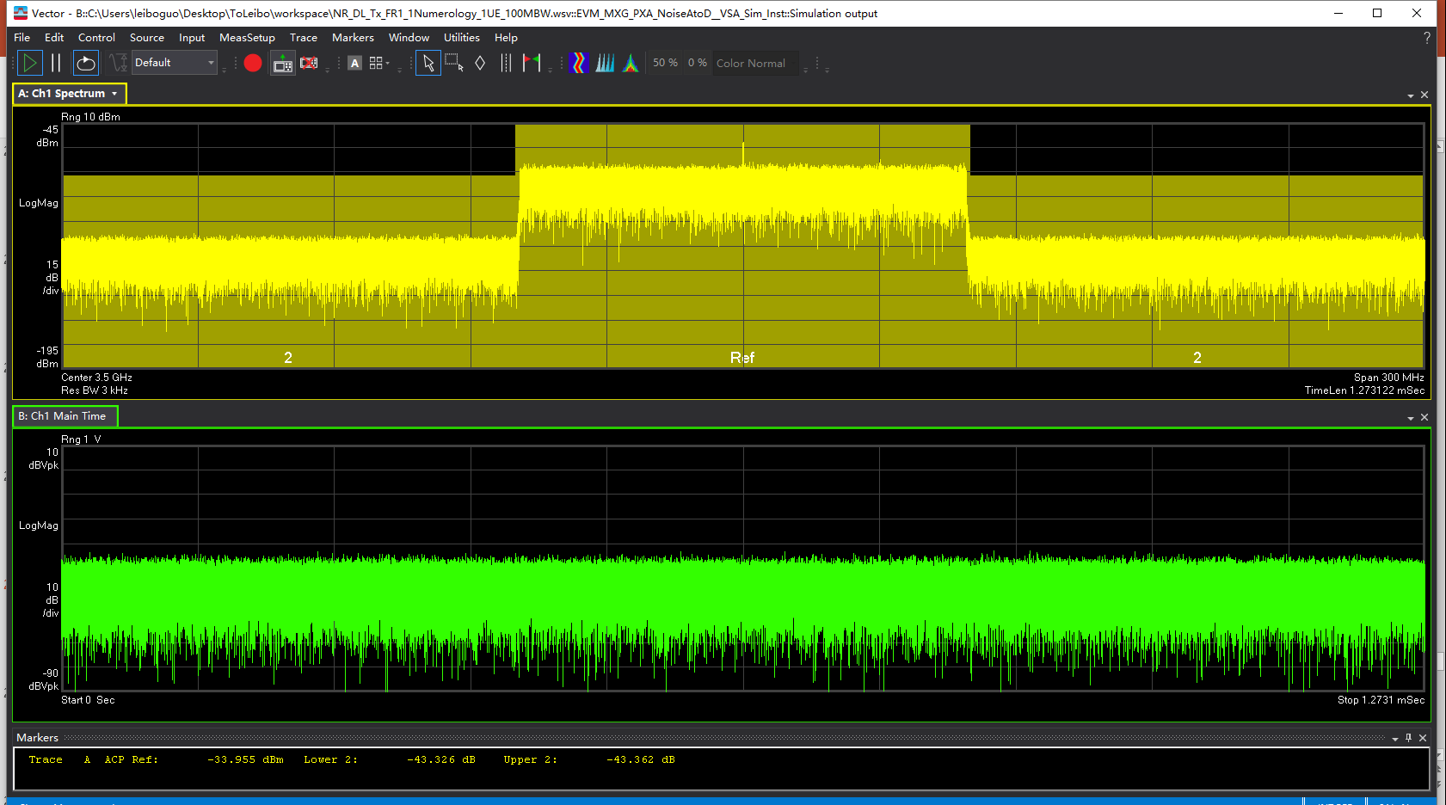
Sim Ideal NR 100M ACLR
Lower ACLR=-43.326
Upper ACLR =-43.362

Slide 29
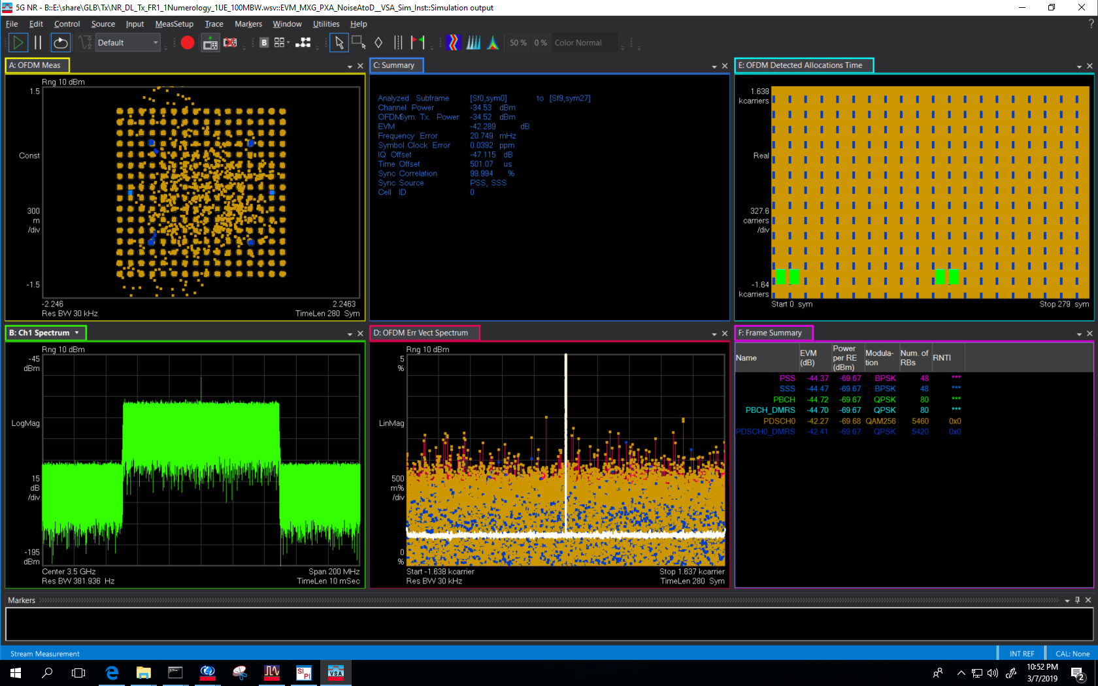
OTA Sim Ideal NR
Pout=10dBm
Gain=0.0022(-53dB)
EVM=-42. 29
IQ offset=-47.115

Slide 30
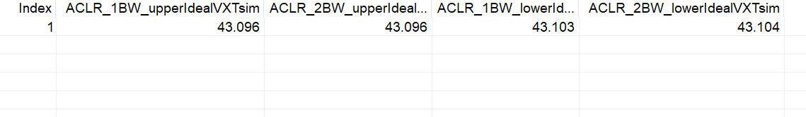
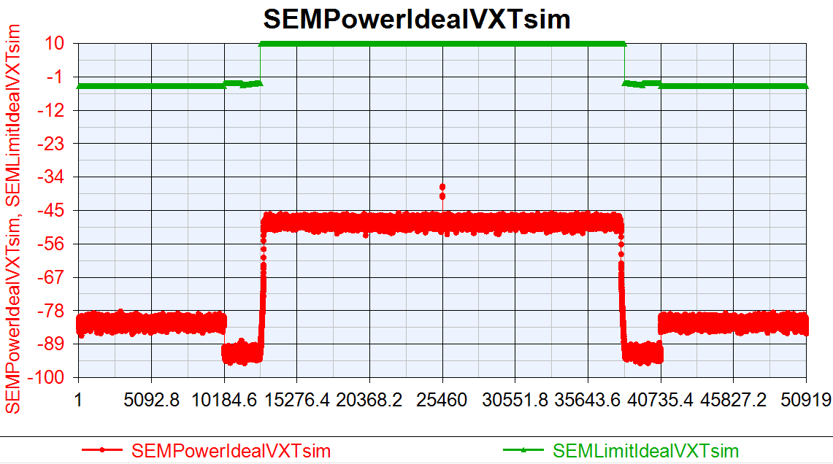
OTA Sim Ideal NR ACLR/SEM

Slide 31
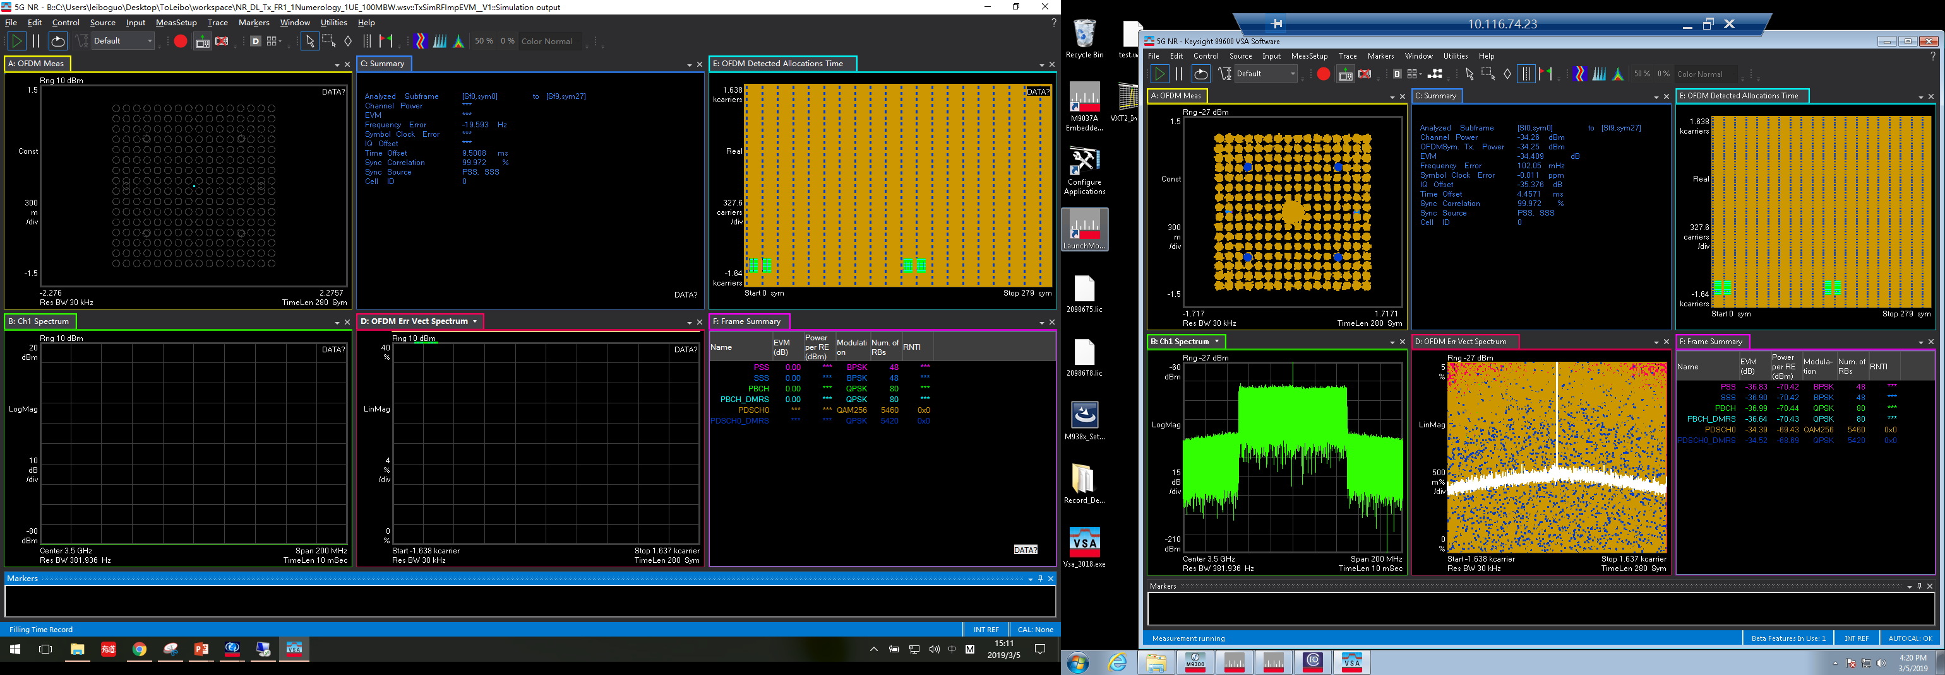
Imp NR 100M Chamber Pout=10dB
IQoffset=0.045
Gain Imb=0.02
PhaseNoise=[100 -88.57 1e3 -97.56 1e4 -111.67]
DAC_Nbits=12
ToIout=20
EVM=-34.409
IQ offset=-35.376

Slide 32
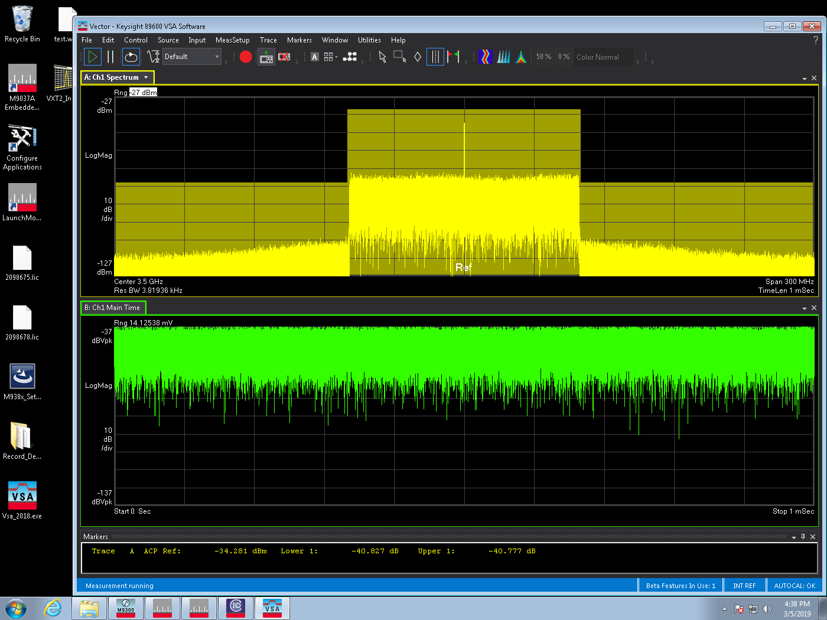
Chamber Imp NR 100M ACLR
Lower ACLR=-40.827
Upper ACLR =-40.777

Slide 33
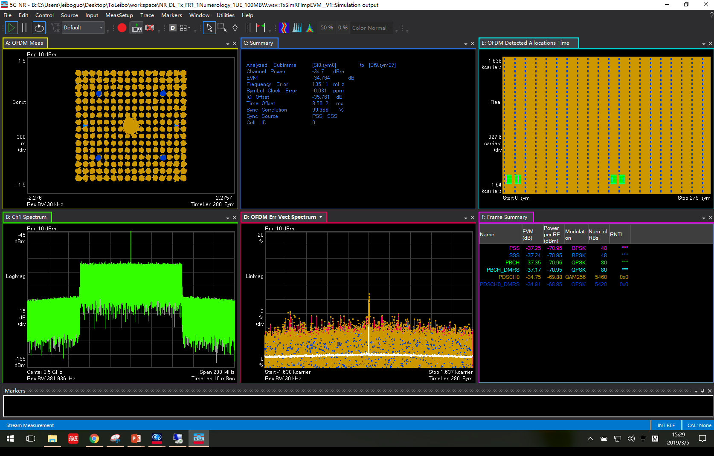
Sim Imp NR 100M Pout=-34dB
IQoffset=0.045
Gain Imb=0.02
PhaseNoise=[100 -88.57 1e3 -97.56 1e4 -111.67]
DAC_Nbits=12
TOIout=20
Density=-158.7
EVM=-34.764
IQ offset=-35.761

Slide 34
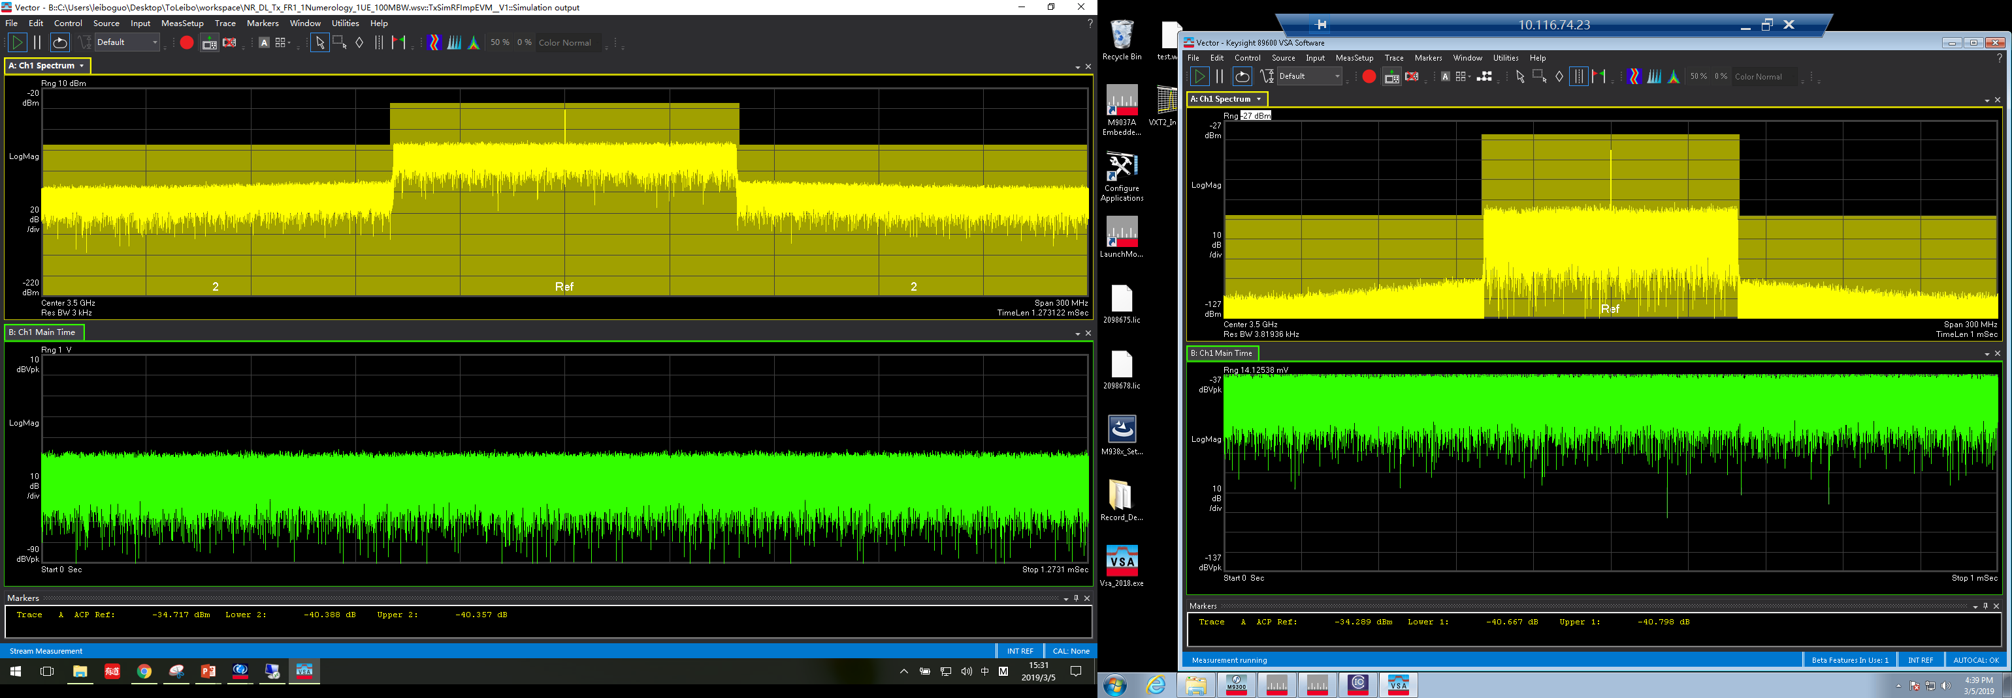
Sim Imp NR 100M ACLR
Lower ACLR=-40.388
Upper ACLR =-40.357

Slide 35
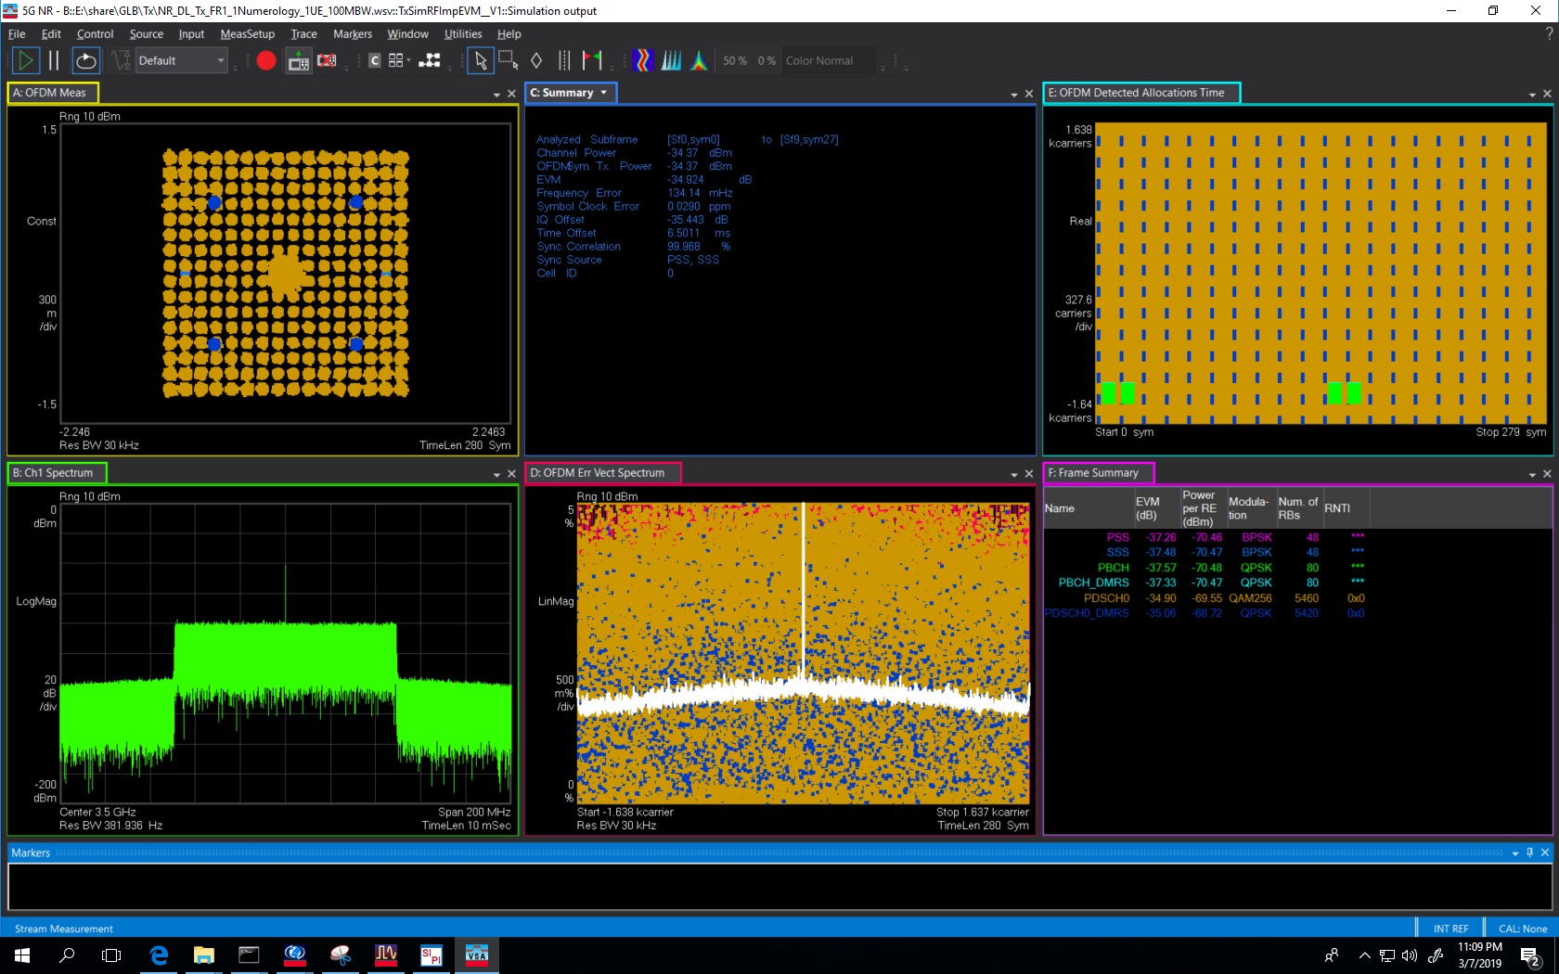
OTA Sim Imp NR
Pout=10dBm
Gain=0.0022(-53dB)
EVM=-34.924
IQ offset=-35.443

Slide 36
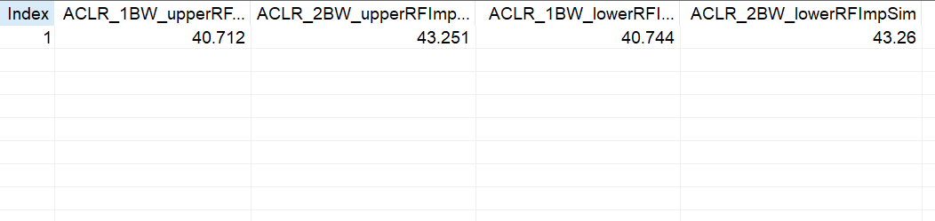
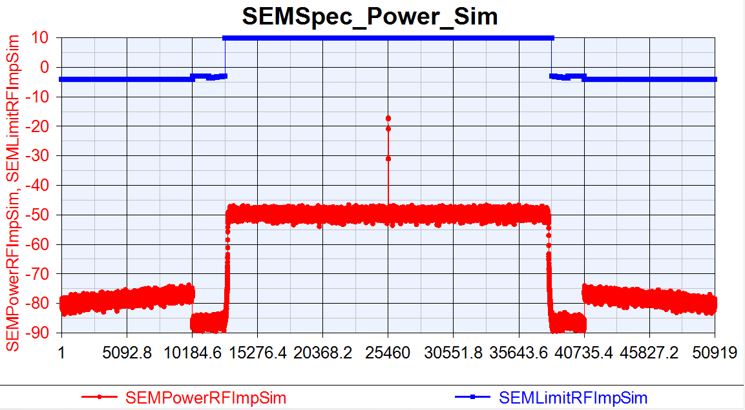
OTA Sim Imp NR ACLR/SEM

